Slide 1
The LWV-Upper Mississippi River Region
Inter League Organization
&
The LWV- Rockford Area
Ask,
“So, How Is the Mississippi
and Why Should We Care?”

Slide 2
What is an “Inter League Organization?”
In recognition of the need to work together at the regional level to solve problems that transcend political borders,
Inter League Organizations or ILOs were added to the formal structures of the LWVUS in 1972.

Slide 4
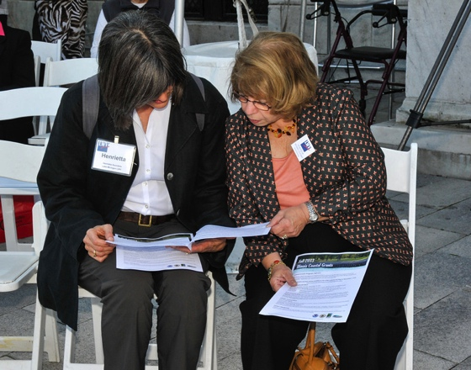
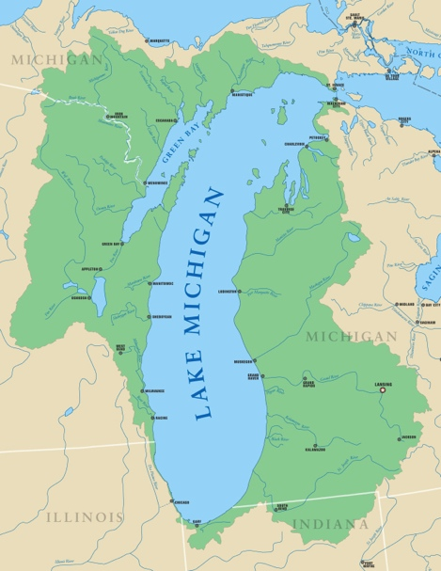
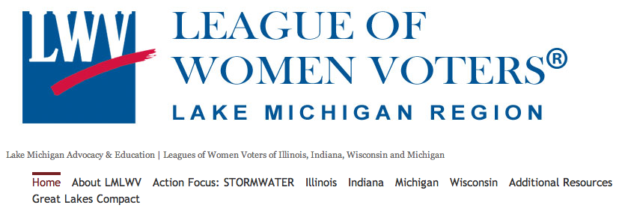
Notes:
One such inter-league organization is the Lake Michigan Region ILO which works primarily on natural resource issues. It coordinates the efforts of 46 local leagues in the states bordering Lake Michigan: Wisconsin, Illinois, Michigan, and Indiana.

Slide 5
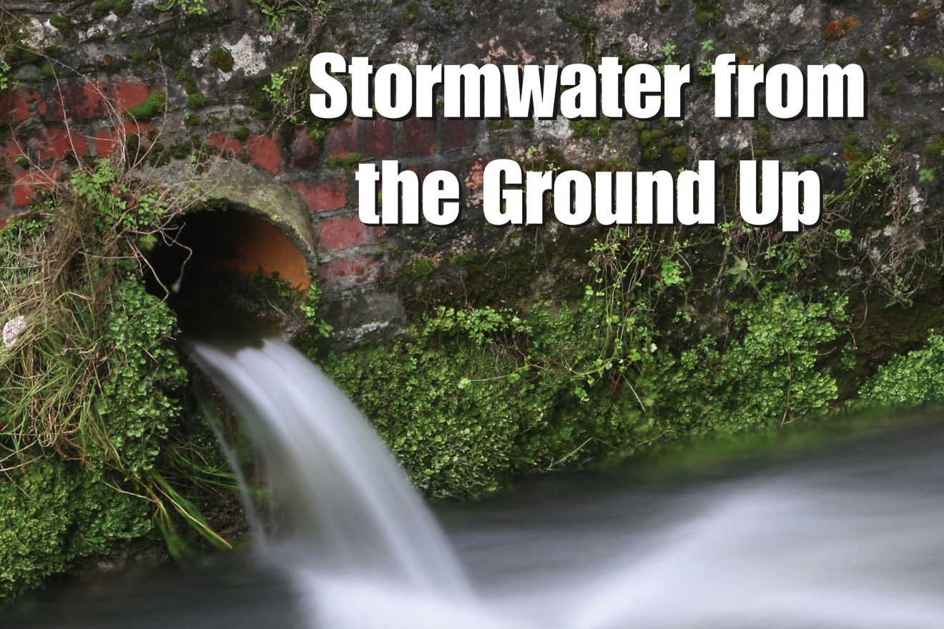
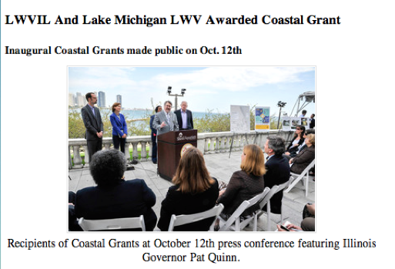

Slide 6
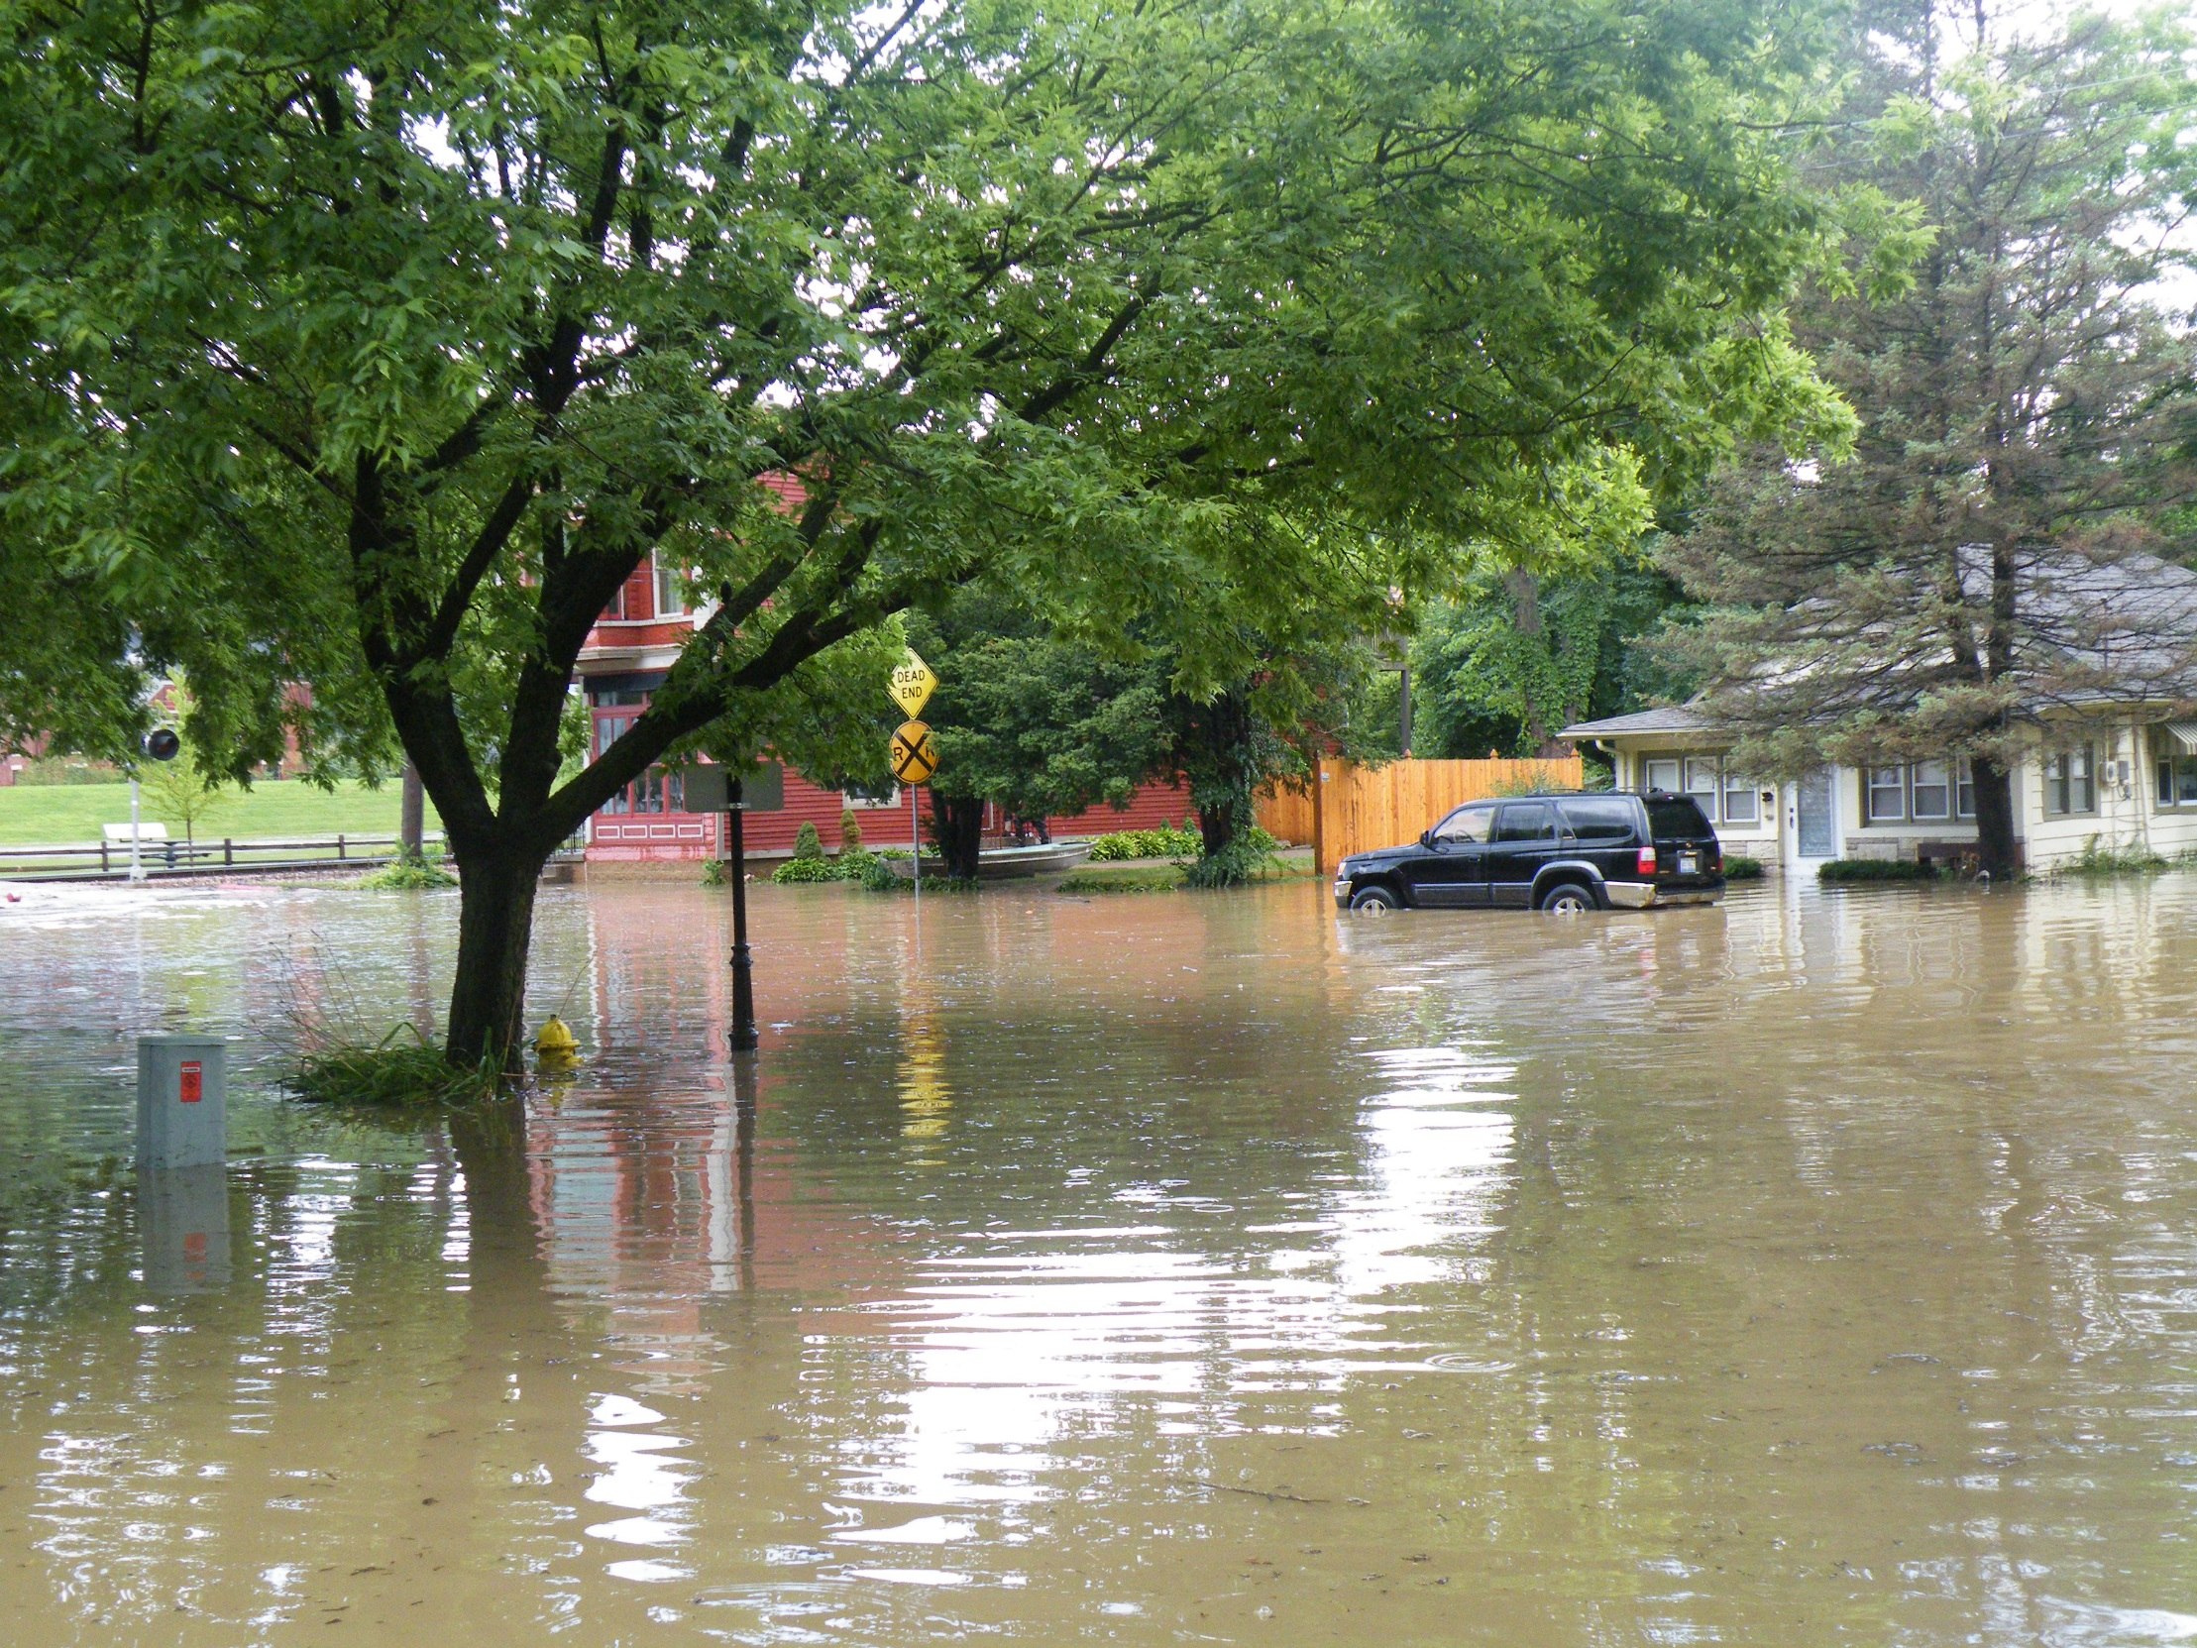
Flooding in Galena
July 2011
Notes:
Although Jo Daviess County, Illinois, and Dubuque, Iowa, don’t border Lake Michigan, storm water management is a big issue for both communities. In the spring of 2014, members of the Lake Michigan ILO presented the storm water program to our communities.

Slide 7
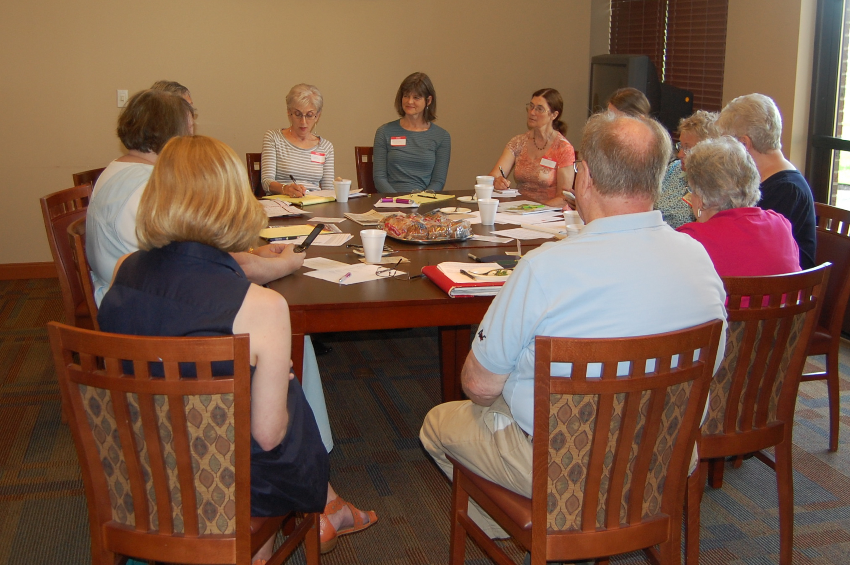

Slide 8
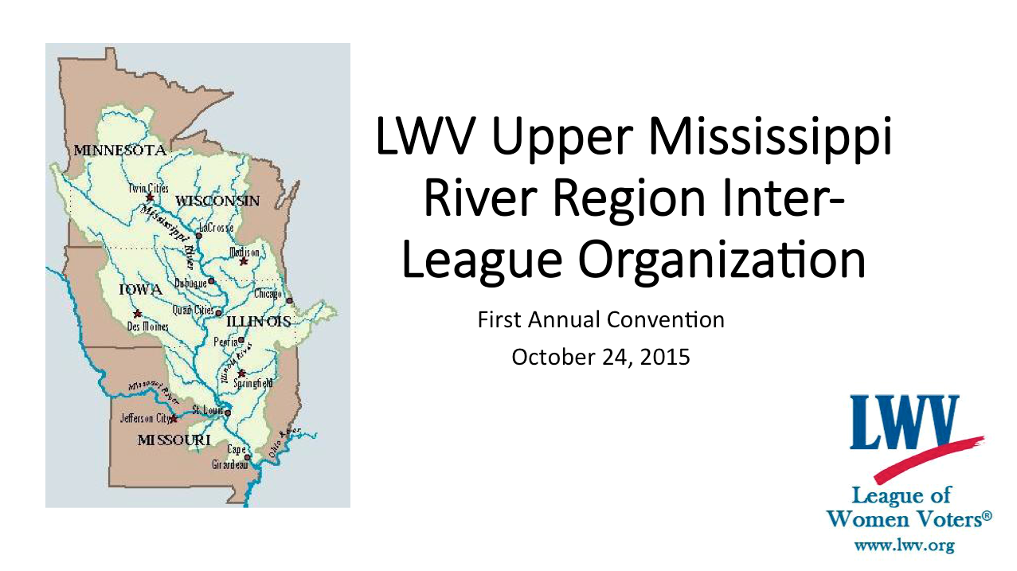
Launching Our ILO, Protecting Our River: Bringing the Passion of Carrie Chapman Catt to the League of Women Voter’s Newest Inter-League Organization

Slide 9
What have we accomplished so far?
Submitted our formal application to the LWVUS after the LWVs of Illinois, Iowa, Minnesota, and Wisconsin and 54 local LWVs across the four states joined.
Submitted our 501c3 application
Developed an Action Committee
With the LWV-Lake Michigan Region representatives, presented a workshop for the LWVIL Issues Briefing
Sent representatives to the Minnesota Water Summit convened by MN Gov. Dayton
We’re on Facebook and our website is being constructed

Slide 10
At the First Annual Meeting of the
LWV-UMRR ILO, delegates selected
“Nutrient Pollution”
as its program focus for its first year
and a half.
What is “nutrient pollution?”

Slide 11
“Too Much of a Good Thing”
Without the phosphorus and nitrogen applied as fertilizers in the world, human civilization in its current form could not exist.
Today giant factories capture inert nitrogen gas from the atmosphere and force it into a chemical union with the hydrogen in natural gas (a process discovered a century ago), creating nitrogen fertilizer. This is what feeds the world today.

Slide 12
“Yet, this modern miracle exacts a price. Runaway nitrogen is suffocating wildlife in lakes and estuaries, contaminating groundwater, and even warming the globe’s climate.”
From “A Mixed Blessing,”
National Geographic, May 2013

Slide 13
Nutrient pollution occurs when excess
nitrogen and phosphorus carried in runoff
from city streets and farm fields or flowing from our wastewater treatment plants fuel algae blooms. When those algae die, the decomposition consumes oxygen. Without sufficient oxygen, fish and other aquatic species die creating “dead zones.”

Slide 14
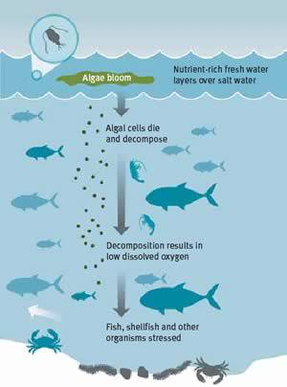
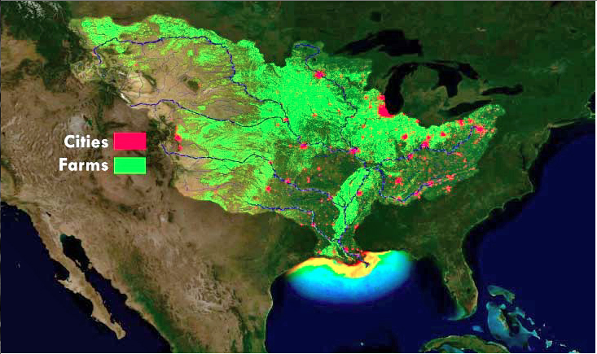
In 2015, the Gulf of Mexico Dead Zone
Covered 6,400 square miles.

Slide 15
Other problems caused by nutrient pollution:
Excess nitrates in water can cause “blue baby syndrome.”
Nutrient pollution can lower property values, hinder recreation, and degrade drinking water. (US EPA estimates that U.S. Tourism loses close to $1 Billion a year through losses in fishing and boating activities.
Removing excess nitrogen, nitrates, and phosphorus is costly.
(DesMoines lawsuit vs. 3 upstream counties)
Some algal blooms are toxic.
(Toledo, Ohio in 2014)

Slide 16
If ingested or contacted, toxins produced by harmful algal blooms can cause:
Skin irritation Stomach Cramps Vomiting
Nausea Diarrhea Fever Headache
Muscle and Joint Pain
Blisters of the Mouth Liver Damage

Slide 17
Why Make “Nutrient Pollution” the First Action Focus for the LWV-UMRR ILO?
All four of our states have developed
“Nutrient Loss Reduction Strategies”
In a 2011 memo to Regional EPA Administrators – referred to as the “Stoner Memo” - 8 recommended elements of a state framework for managing nitrogen and phosphorous pollution were provided to guide development of the state strategies. The eventual goal is that all states will achieve a 45% reduction in the amount of both phosphorus and nitrogen that eventually discharge to the Mississippi.

Slide 18
The LWV-Lake Michigan ILO and the LWV-UMRR ILO are collaborating to help local LWVs work on “nutrient pollution” issues in their communities on a watershed basis.
Why at the watershed level?
Because the principle source of phosphorus and nitrogen is “non point” source pollution – the diffuse pollution from myriad inputs that accumulates into a problem at the watershed level.

Slide 19
Non Point Source Contributors to Nutrient Pollution
Fertilizer and Animal Waste from Agriculture
Stormwater Runoff and Erosion
Lawn Fertilizers and Pet Waste
Atmospheric Deposition from Vehicle Exhaust and
Coal and Oil-Burning Power Plant Emissions
Point Source Contributors to Nutrient Pollution
Some farms are regulated as Point Sources
Waste water treatment plants without the technology to remove the nitrogen and phosphorus from human waste, food, and some soaps and detergents

Slide 20
“100 Meetings Honoring 100 Years”
Goals of these meetings:
1. Target League public outreach efforts toward watershed information.
2. Tailor each meeting to the community watershed issues and interests.
3. Work with partners to provide meeting content, materials, and speakers.
4. Encourage LWVs to spread the word, build collaboration, and focus on actions

Slide 21
Examples of Spreading the Word, Growing Collaboration, and Focusing on Action
By the LWV of Jo Daviess County

Slide 22
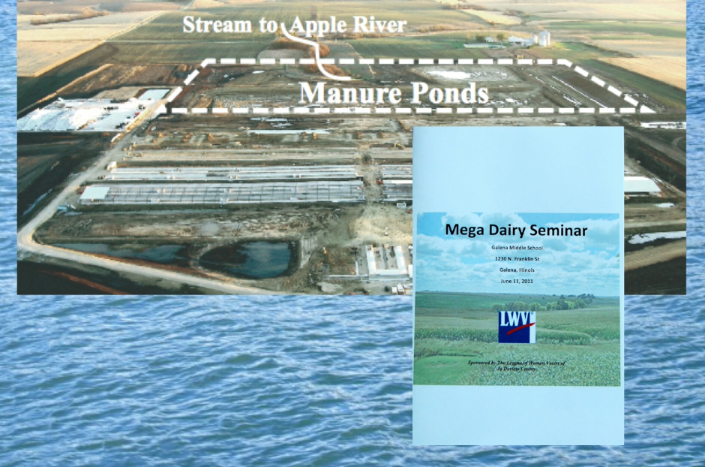

Slide 23
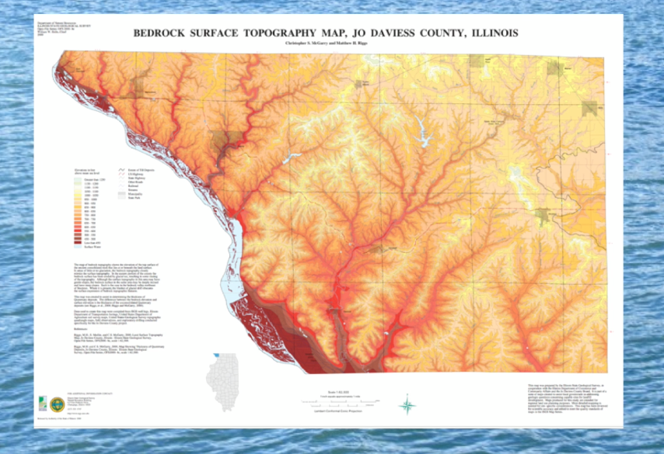

Slide 24
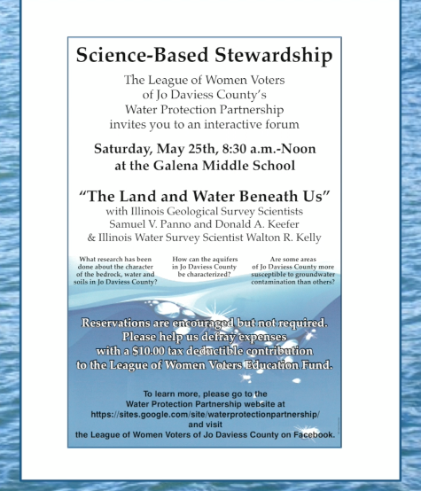
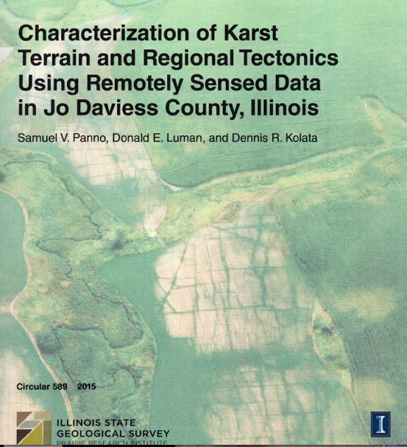

Slide 25
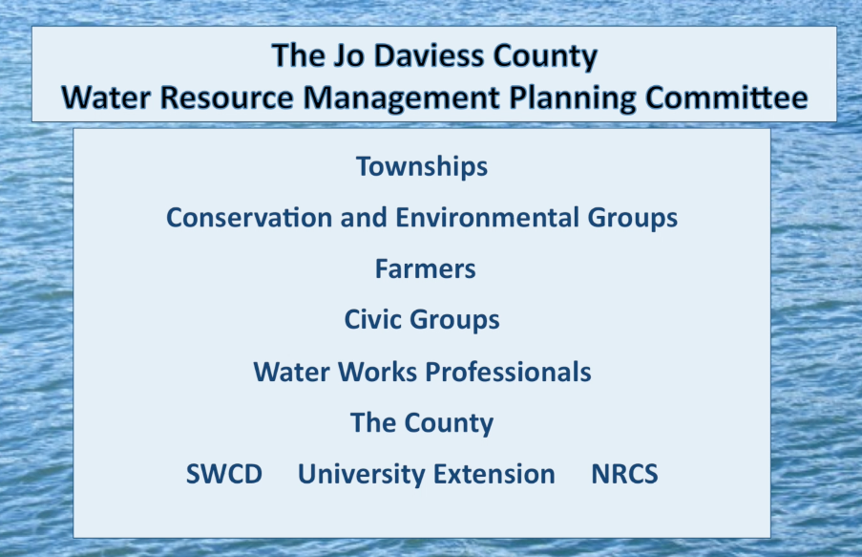

Slide 26
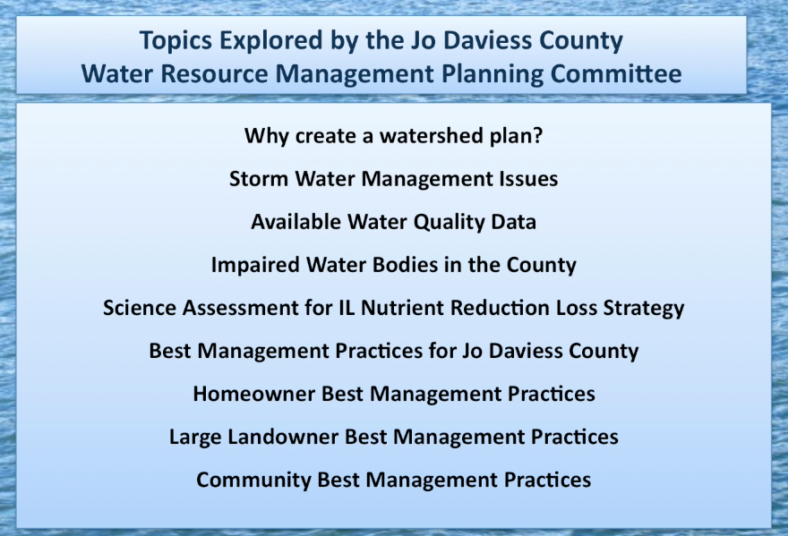

Slide 27
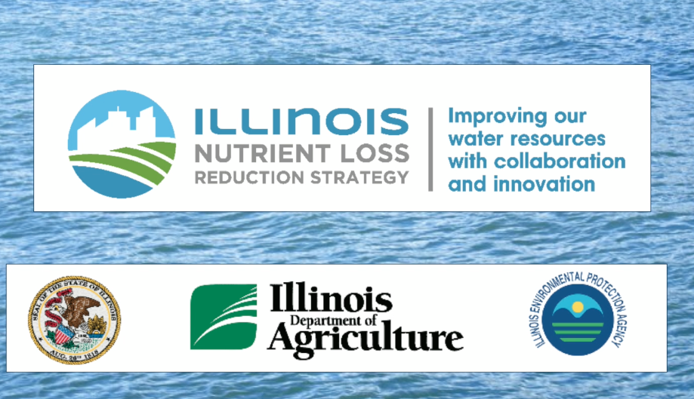

Slide 28
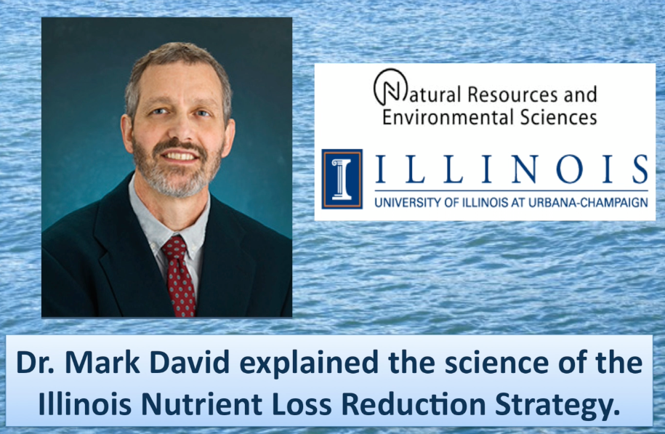

Slide 29
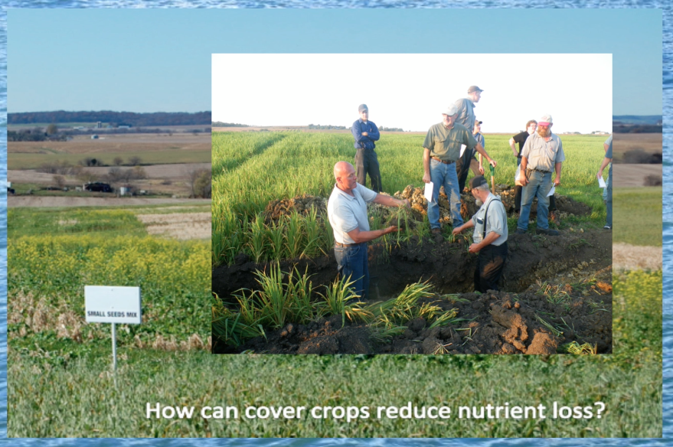

Slide 30
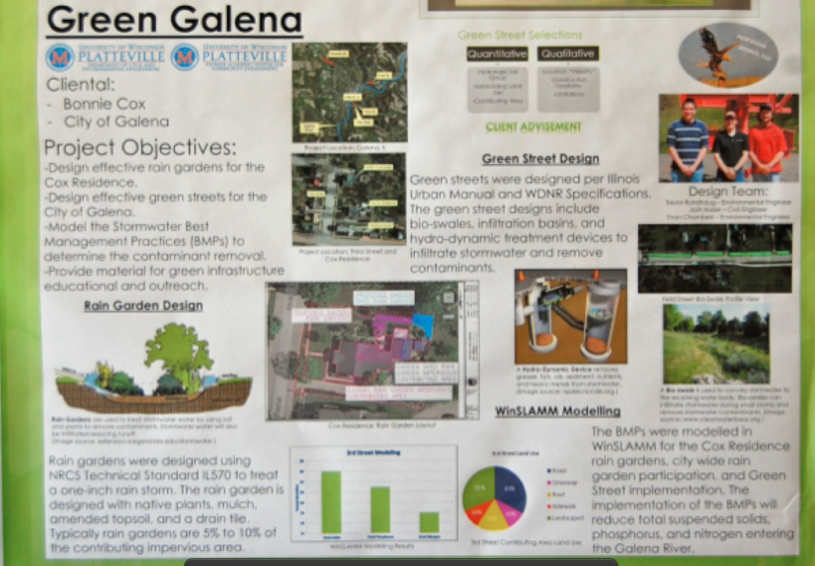

Slide 31
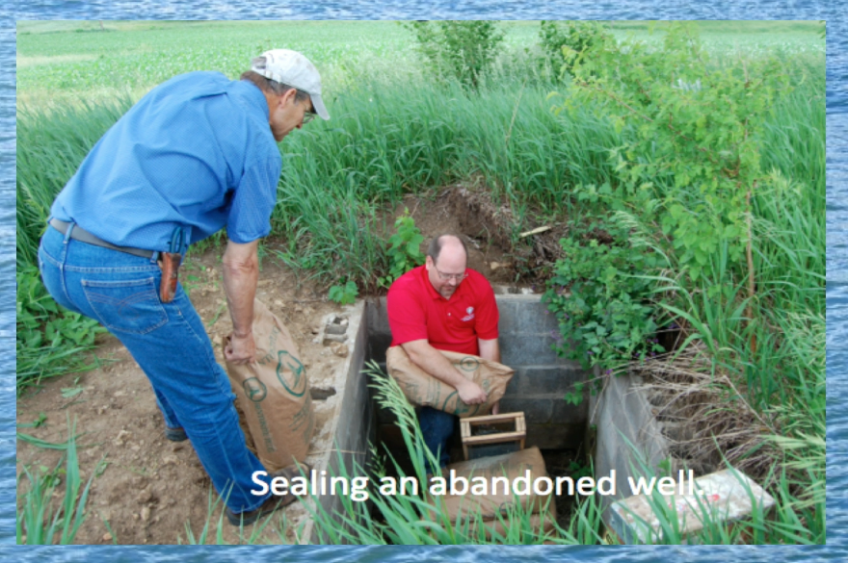

Slide 32
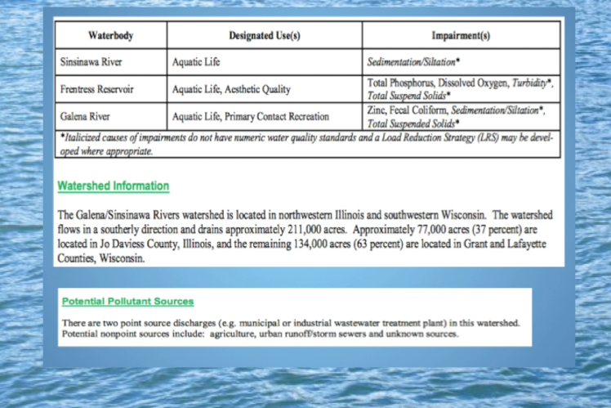

Slide 33
Our LWV and the City of Galena applied for an Illinois EPA 319 Grant to Clean Up Sections of the Galena River
Our LWV Applied for U.S. Fish and Wildlife Grant to Complete Testing for Another 18 Springs in the County

Slide 34
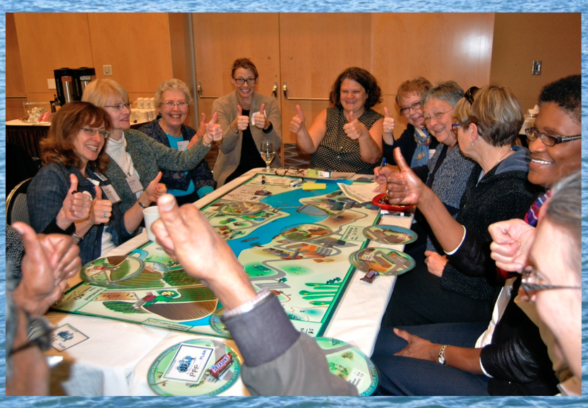
Submitted a grant proposal to the local Lions’ Club for the purchase of the Watershed Game and the cost of training game facilitators.

Slide 35
